Slide 1
Dayananda Sagar College of Engineering
(Shavige Malleshwara Hills, Kumaraswamy Layout, Bengaluru – 560 078)
Department of Electronics and Communication Engineering
Emerging Technology Mini-Project
PHYSICAL LAYER WIRED AND WIRELESS SECURITY
NAME
Vishvendra Singh
Tanvi Vijay
Saurabh Singh
Sameer Gautam
USN
1DS18EC156
1DS18EC153
1DS18EC144
1DS18EC143

Slide 2

INDEX
Overview
Physical Security in Wired Networks
Physical Security in Wireless Networks

Slide 3
INTRODUCTION
Networks are made up of devices and communication links.
Devices and links can be physically threatened.
Vandalism, lightning, fire, excessive pull force, corrosion, wildlife, wear-down, wiretapping, crosstalk, jamming.
We need to make networks mechanically resilient and trustworthy.

Slide 4
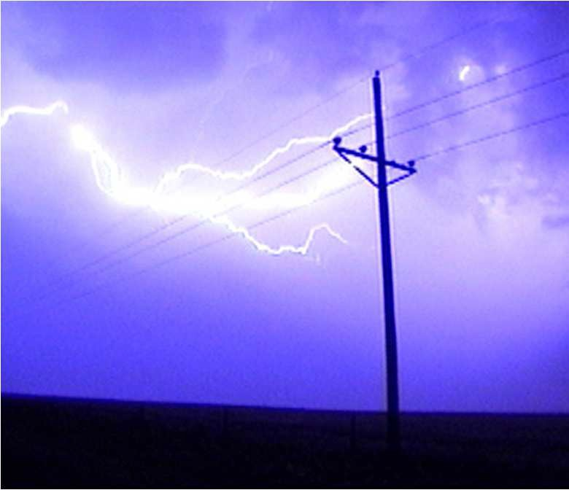


3

Slide 5

How can two computers communicate?
Encode information into physical “signals”
Transmit those signals over a transmission medium

Slide 6
TYPES OF MEDIA
Metal (e.g., copper): wired
EM/RF (e.g., IEEE 802.11): wireless
Light (e.g., optical fiber)

Slide 7
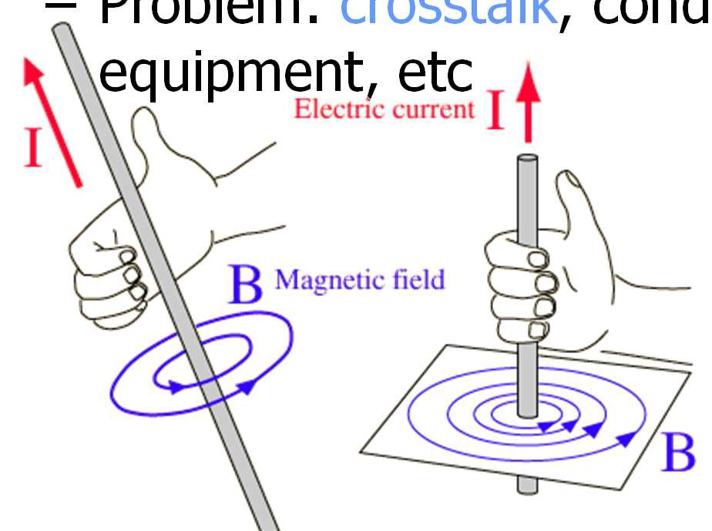
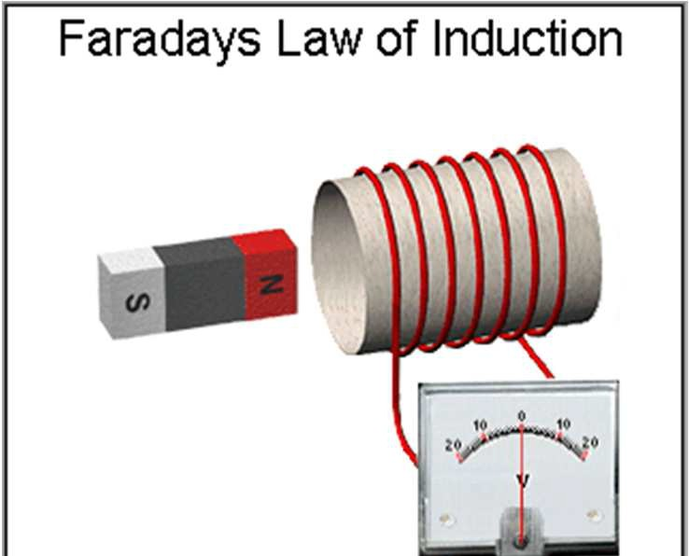
Noise, Jamming, and Information Leakage
PHYSICAL SECURITY IN WIRED NETWORKS
When you move a conductor through a magnetic field, electric current is induced (electromagnetic induction)
EMI is produced from other wires or devices
Induces current fluctuations in conductor
Problem: crosstalk, conducting noise to equipment, etc
16

Slide 8
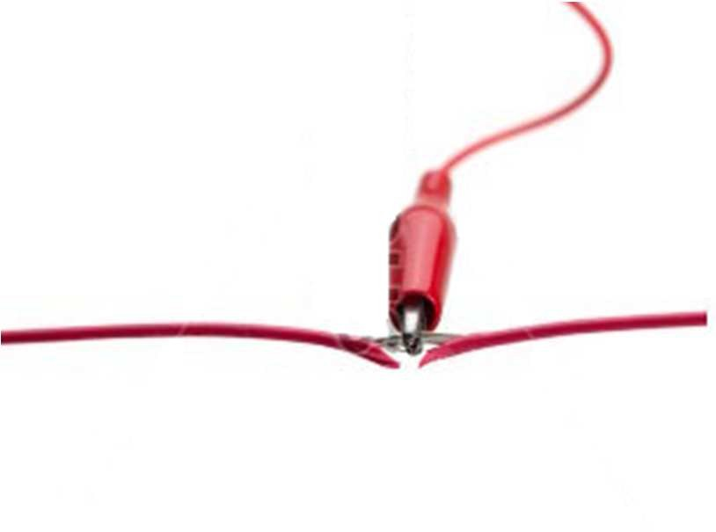
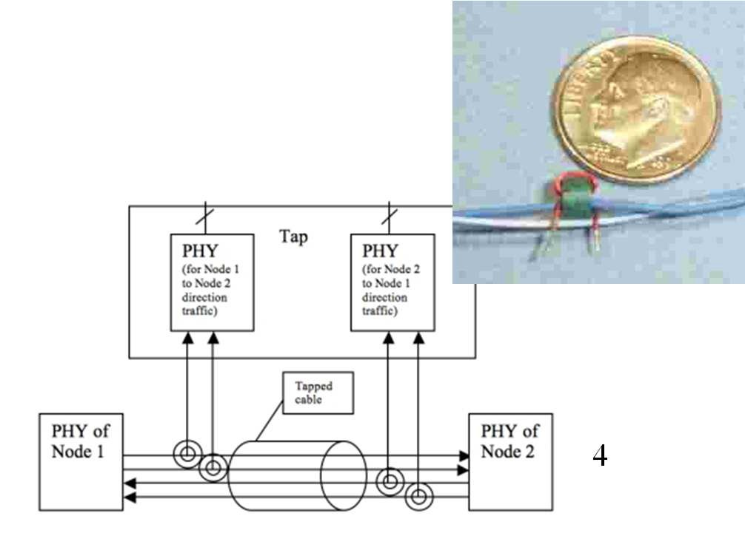
PHYSICAL TAPPING
Conductive Taps
Form conductive connection with cable
Inductive Taps
Passively reads signal from EM induction
No need for any direct physical connection
Harder to detect
Harder to do with non- electric conductors (e.g., fiber optics)
24

Slide 9
TAPPING CABLE: COUNTERMEASURES
Physical inspection
Physical protection
E.g., encase cable in pressurized gas
Use faster bitrate
Monitor electrical properties of cable
TDR: sort of like a hard-wired radar
Power monitoring, spectrum analysis
25

Slide 10

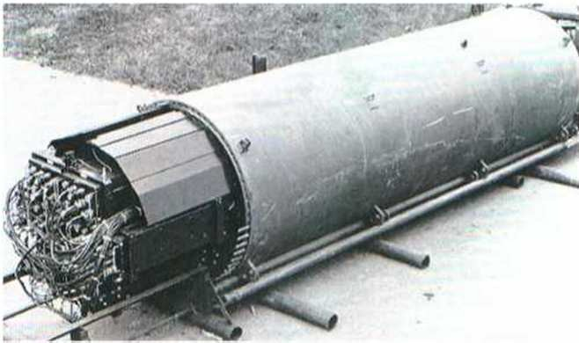
CASE STUDY: SUBMARINE CABLE (IVY BELLS)
1970: U.S. learned of USSR undersea cable
Connected Soviet naval base to fleet headquarters
Joint US Navy, NSA, CIA operation to tap cable in 1971
Saturation divers installed a 3-ft long tapping device
Coil-based design, wrapped around cable to register signals by induction
Signals recorded on tapes that were collected at regular intervals
Communication on cable was unencrypted
Recording tapes collected by divers monthly
26

Slide 11
CASE STUDY: SUBMARINE CABLE (IVY BELLS)
1972: Bell Labs develops next-gen tapping device
20 feet long, 6 tons, nuclear power source
Enabled
No detection for over a decade
Compromise to Soviets by Robert Pelton, former employee of NSA
Cable-tapping operations continue
Tapping expanded into Pacific ocean (1980) and Mediterranean (1985)
USS Parche refitted to accommodate tapping equipment, presidential commendations every year from 1994-97
Continues in operation to today, but targets since 1990 remain classified
27

Slide 12
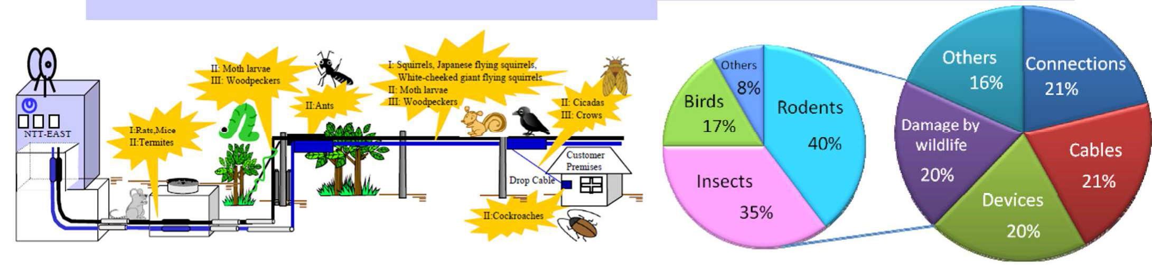
PROTECTION AGAINST WILDLIFE
Rodents (squirrels, rats, mice, gophers)
Chew on cables to grind foreteeth to maintain proper length
Insects (cicadas, ants, roaches, moths)
Mistake cable for plants, burrow into it for egg laying/larvae
Ants invade closures and chew cable and fiber
Birds (crows, woodpeckers)
Mistake cable for twigs, used to build nests
Underground cables affected mainly by rats/termites, aerial cables by rodents/moths, drop cables by crows ,closures by ants

Slide 13
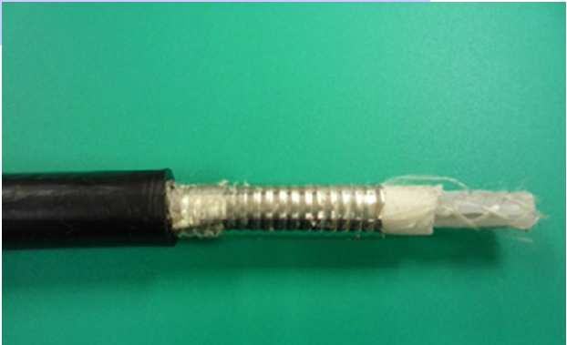
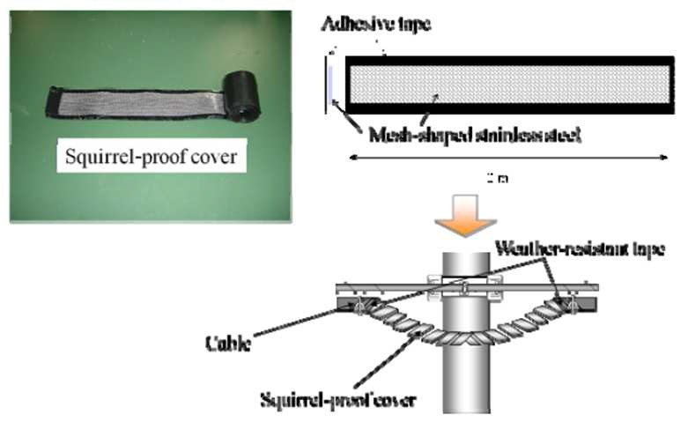
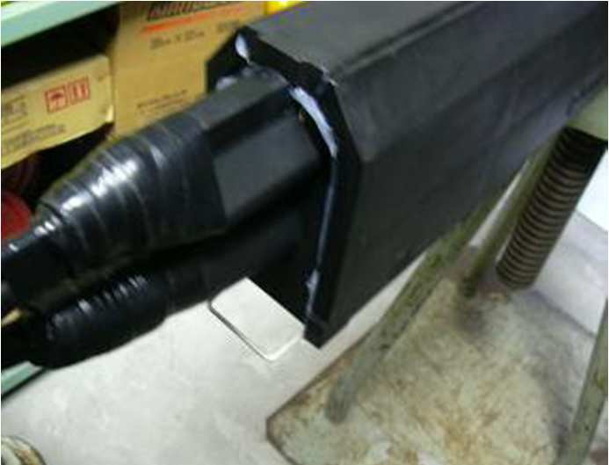
COUNTERMEASURES AGAINST WILDLIFE
Use High Strength Sheath cable
PVC wrapping stainless steel sheath
Performance studies on cable (gnathodynameter)
Cable wrap
Squirrel-proof covers: stainless steel mesh surrounded by PVC sheet
Fill in gaps and holes
Silicone adhesive
Use bad-tasting cord
PVC infused with irritants
Capsaicin: ingredient in pepper spray, irritant
Denatonium benzoate: most known bitter compound
36

Slide 14
PHYSICAL ATTACKS IN WSNS: WHAT & WHY?
Physical attacks: destroy sensors physically
Physical attacks are inevitable in sensor networks
Sensor network applications that operate in hostile environments
Volcanic monitoring
Battlefield applications
Small form factor of sensors
Unattended and distributed nature of deployment
Different from other types of electronic attacks
Can be fatal to sensor networks
Simple to launch
Defending against physical attacks
Tampering-resistant packaging helps, but not enough
We propose a sacrificial node based defense approach to search-based physical attacks
Notes:
Physical attacks can permanently destroy the sensors, which are different from electronic attacks such as jamming attacks, which tries to interfere the radio channels and interrupt the sensor networks’ operation.
Emphasize that physical attacks are simple to lunch.

Slide 15
PHYSICAL ATTACKS IN WSNS – A GENERAL DESCRIPTION
Two phases
Targeting phase
Destruction phase
Two broad types of physical attacks:
Blind physical attacks
Search-based physical attacks

Slide 16

BLIND PHYSICAL ATTACKS IN WSNS
Notes:
Due to the brute-force destruction methods and blindly selecting attack areas

Slide 17
MODELING SEARCH-BASED PHYSICAL ATTACKS IN WSNS
Sensor network signals
Passive signal and active signal
Attacker capacities
Signal detection
Attacker movement
Attacker memory
Attack Model
Attacker objective
Attack procedure and scheduling
Notes:
Passive signals include heat, vibration, magnetic signals which are parts of the constant physical characteristics of the sensors. Active signals on the other hand include communication
messages, beacons, query messages etc., that are part of normal communications between sensors in the network.
Signal strength, active, passive signal detection range, active signal frequency
cluster-head: large active signal detection range, cluster-head rotation frequency
The cluster-head rotation is used to balance the power consumption and reduce the damage due to the destruction of the cluster-head
Isolation/detection accuracy
Attacker moving and destruction speed

Slide 18
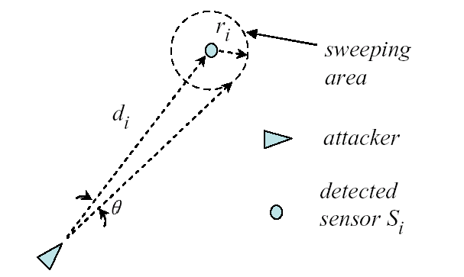
SIGNAL DETECTION
d_{i}: Estimated distance
θ: Isolation accuracy
Direction/Angle of arrival
πr_{i}²: Isolation/sweeping area
r_{i} =d_{i} * θ
Attacker’s detection capacity is stronger than that of sensors

Slide 19
NETWORK PARAMETERS AND ATTACKER CAPACITIES
f : Active signal frequency
R_{noti}: message transmission range
R_{a}: The maximum distance the attacker is detected by active sensors
R_{s}: Sensing range
R_{ps}: Max. distance for passive signal detection
R_{as}: Max. distance for active signal detection
v: Attacker moving speed
M: Attacker memory size

Slide 20
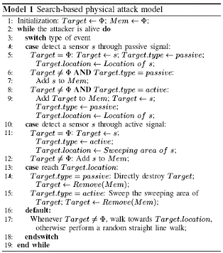
ATTACKER OBJECTIVE AND ATTACK PROCEDURE
AC: Accumulative Coverage
EL: Effective Lifetime, the time period before the coverage falls below a threshold α
Objective: Minimize AC
Notes:
AC measures both coverage and lifetime of sensor networks.
During the scheduling of attack activities, the attacker needs to choose between normal sensors and the cluster-head if the time cost to destroy them is same
Need more time to reach cluster-heads and the corresponding sweeping areas are larger.

Slide 21
DISCUSSIONS ON SEARCH-BASED PHYSICAL ATTACKS IN WSNS
Differentiate sensors detected by active/passive signals
Sensors detected by passive signals are given preference
Scheduling the movement when there are multiple detected sensors
Choose sensors detected by passive signals first
Choose the one that is closest to the attacker
Optimal scheduling?
Due the dynamics of the attack process, it is hard to get the optimal path in advance

Slide 22
DEFENDING AGAINST SEARCH-BASED PHYSICAL ATTACKS IN WSNS
Assumptions
Sensors can detect the attacker or
Destroyed sensors can be detected by other sensors
Attacker’s detection capacity is stronger than sensors, but not unlimited
A simple defense approach
Our sacrificial node based defense approach

Slide 23

A SIMPLE DEFENSE APPROACH
: Attacker
: Sensor
R_{noti}
s₃
R_{noti}
s₇
R_{noti}
s₁
s₄
s₂
s₆
s₅

Slide 24
OUR DEFENSE APPROACH
Adopting Sacrificial Nodes (sensors) to improve monitoring of the attacker and to increase the protection areas
A sacrificial node is a sensor that keeps active in proximity of the attacker in order to protect other sensors at the risk of itself being detected and destroyed
Attack Notifications from victim sensors
States Switching of receiver sensors of Attack Notifications to reduce the number of detected sensors

Slide 25
DEFENSE PROTOCOL
3
3
1: receive AN,
not be sacrificial node
2: receive AN,
be sacrificial node
3: not receive AN,
receive SN
4: T₁ expires
5: T₂ or T₃ expires
6: destroyed by attacker
Sending
(nonsacrificial
node)
5
Sensing
1
6
6
2
Destroyed
4
1
2
6
6
Sending
(sacrificial node)
1
Sleeping
3
2

Slide 26
AN ILLUSTRATION OF OUR DEFENSE APPROACH
: Attacker
: Sensor
R_{noti}
s₃
R_{noti}
s₇
R_{noti}
s₁
s₄
s₂
s₆
s₅

Slide 27
DISCUSSIONS ON OUR DEFENSE PROTOCOL
Trade short term local coverage for long term global coverage
Sacrificial nodes compensate the weakness of sensors in attack detection
Our defense is fully distributed
Sacrificial node selection
Who should be sacrificial nodes?
State switching - timers
When to switch to sensing/sleeping state to prevent detection?
When to switch back to sensing/sending state to provide coverage?

Slide 28
SACRIFICIAL NODE SELECTION
Principle
The more the potential nodes protected can be, higher is the chance to be sacrificial node
Solution
Utility function u(i) is computed by each sensor based on local information
Sensor i decides to be sacrificial node if u(i) ≥ U_{th}
U_{th} = β * U_{ref} (0<β<1); U_{ref} = N * π * R²_{noti} / S

Slide 29
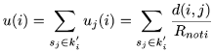
UTILITY FUNCTION U(I)
What is the basic idea of u(i)?
The more nodes being protected, the larger u(i) is
Overlap is discounted
Distance matters
Theorem 1: The utility function u(i) is optimal in terms of minimizing the expected mean square error between u(i) and u^{opt}(i)

Slide 30
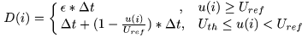
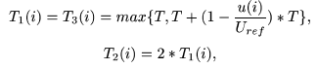
STATE SWITCHING
D(i): Random delay for SN message
T(i): timers for states switching

Slide 31
PERFORMANCE EVALUATION
Network parameters:
S: 500 * 500 m²
N: 2000
α: 0.5
f: 1 / 60 second
R_{noti}: 20 m
R_{a}: 0.1 m
R_{s}: 10 m
Attack parameters:
R_{ps}: 5 m
R_{as}: 20 m
v: 1 m/second
M: 2000
Protocol parameters:
β: 0.7
Δt: 0.01 second
T: 20 seconds

Slide 32
DEFENSE EFFECTIVENESS UNDER DIFFERENT NETWORK PARAMETERS

Slide 33
DEFENSE EFFECTIVENESS UNDER DIFFERENT ATTACKER PARAMETERS

Slide 34
SUMMARY
Physical Security in Wired Networks
Tapping attacks
Case studies
Physical Security in Wireless Networks
Physical attacks are patent and potent threats to sensor networks
A Sacrificial Node-assisted approach to defend against physical attacks
Cryptography

